Slide 1
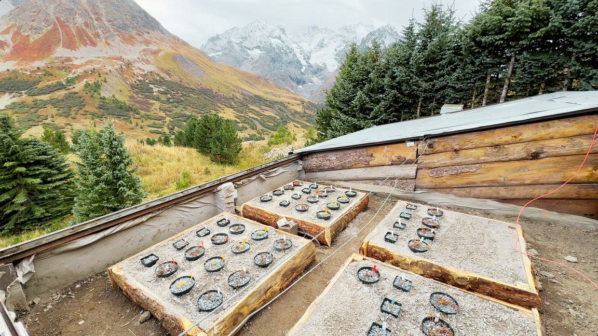
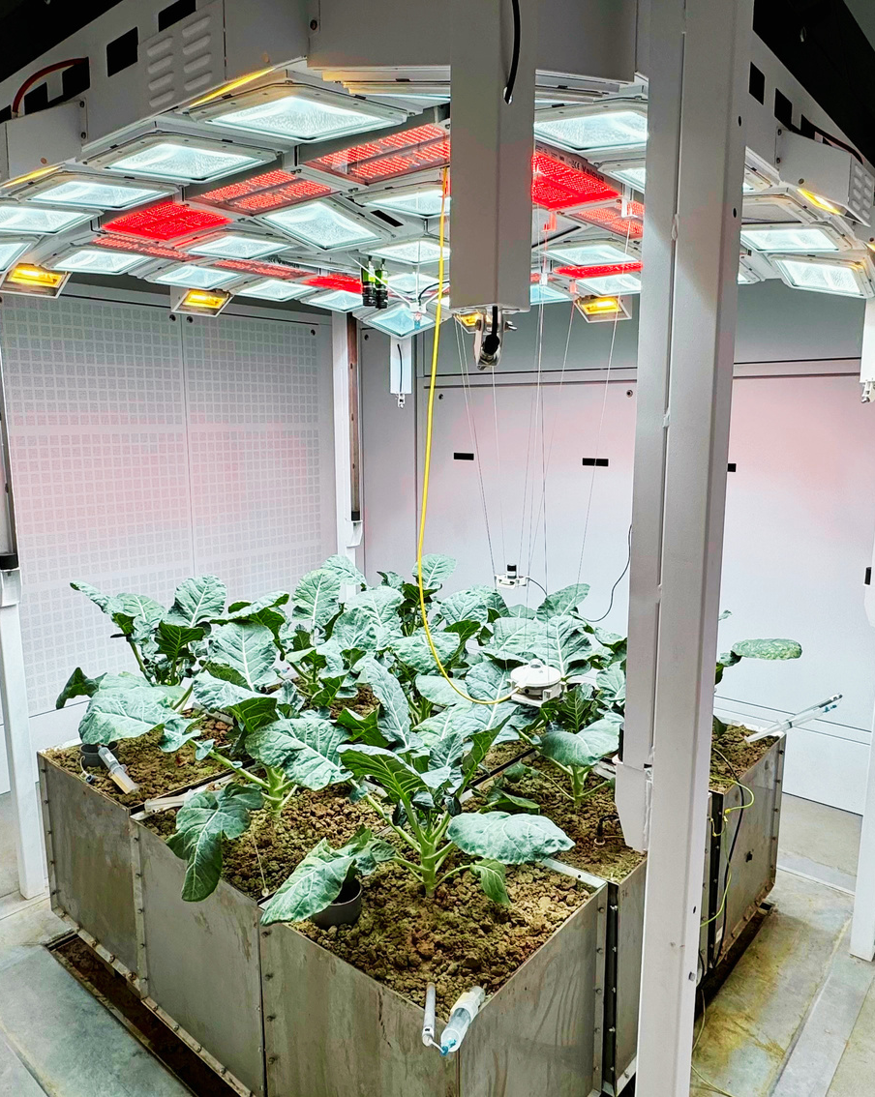

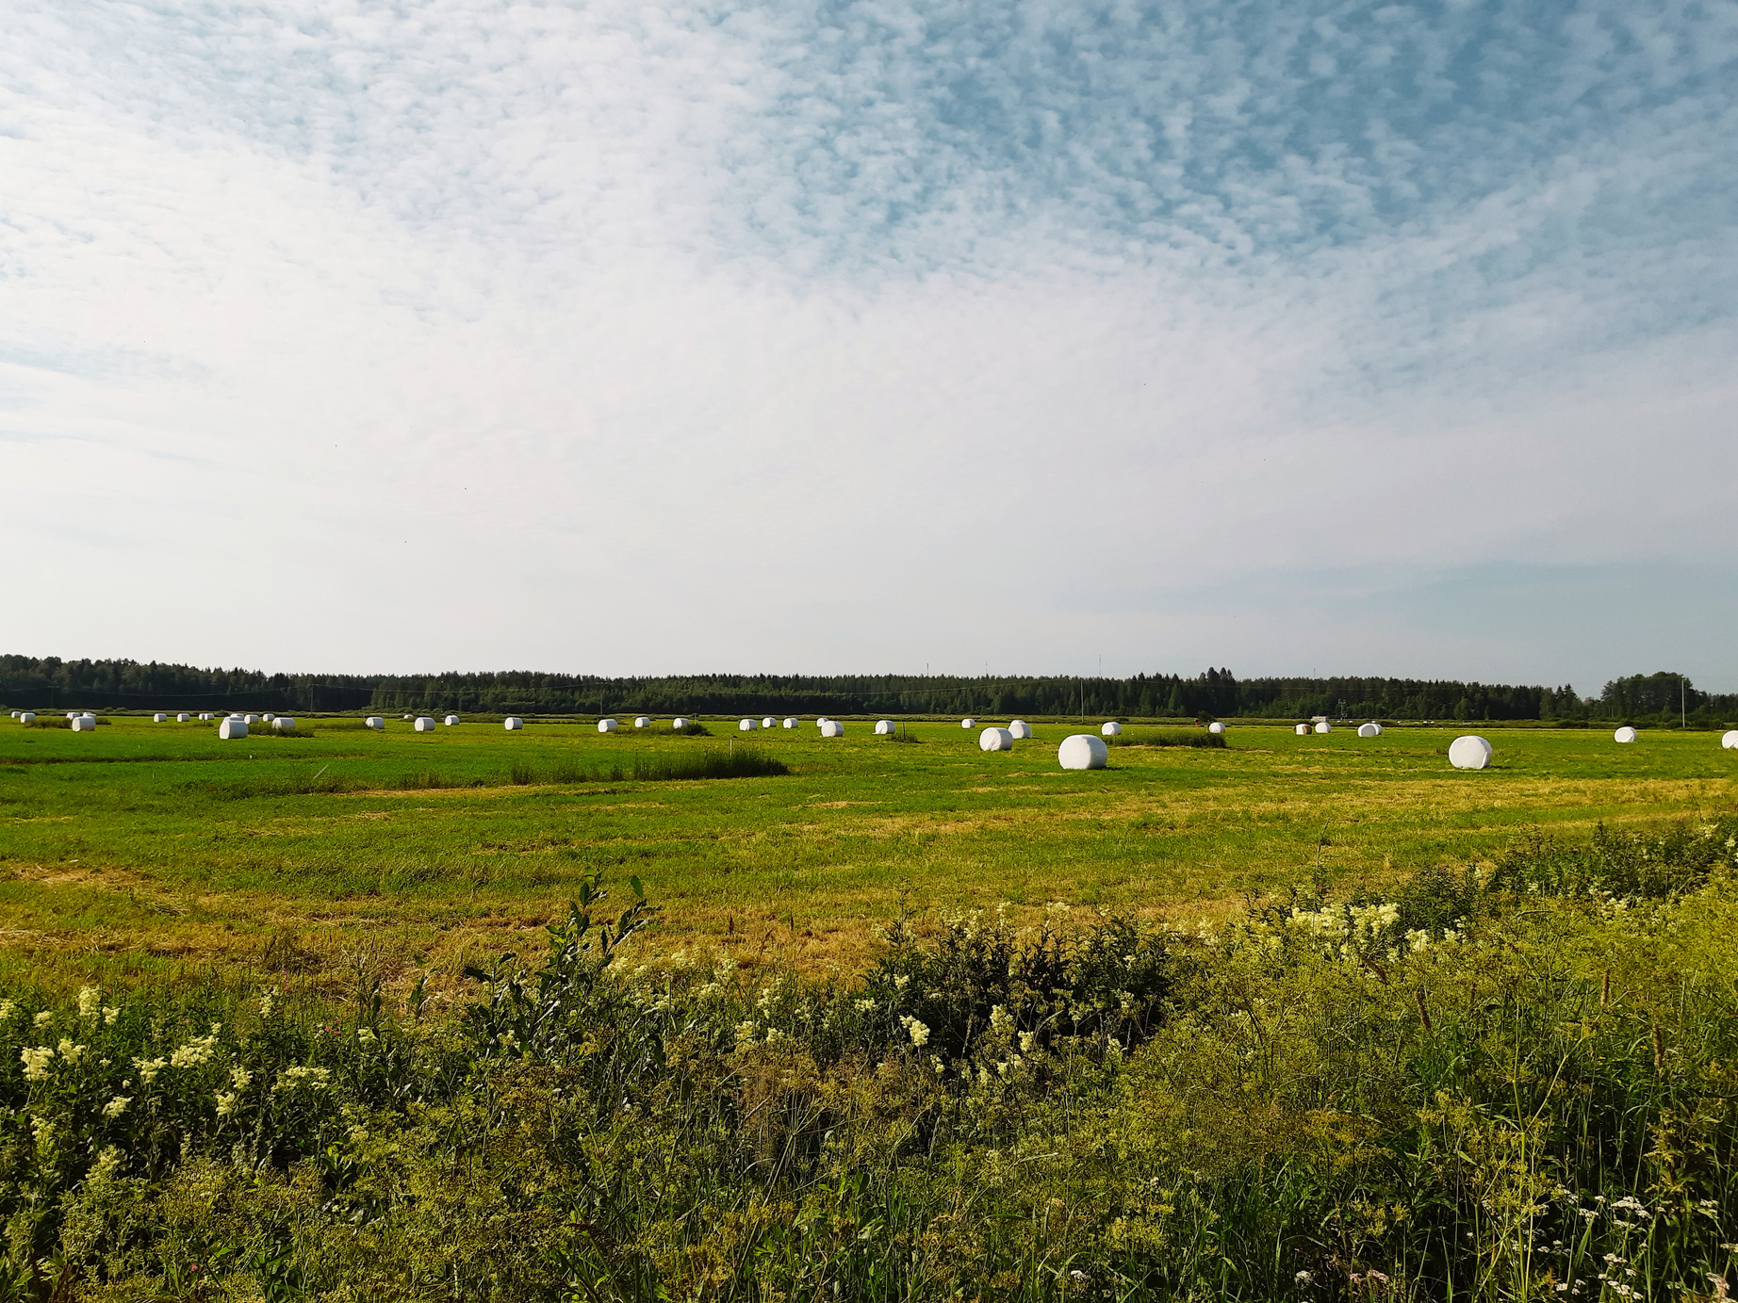
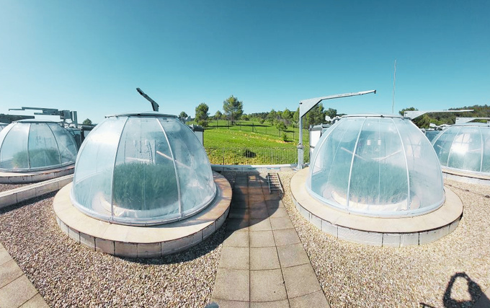
Analysis and Experimentation on Ecosystems
advancing ecosystem science in a changing
world
A BRIEF PRESENTATION

Slide 2
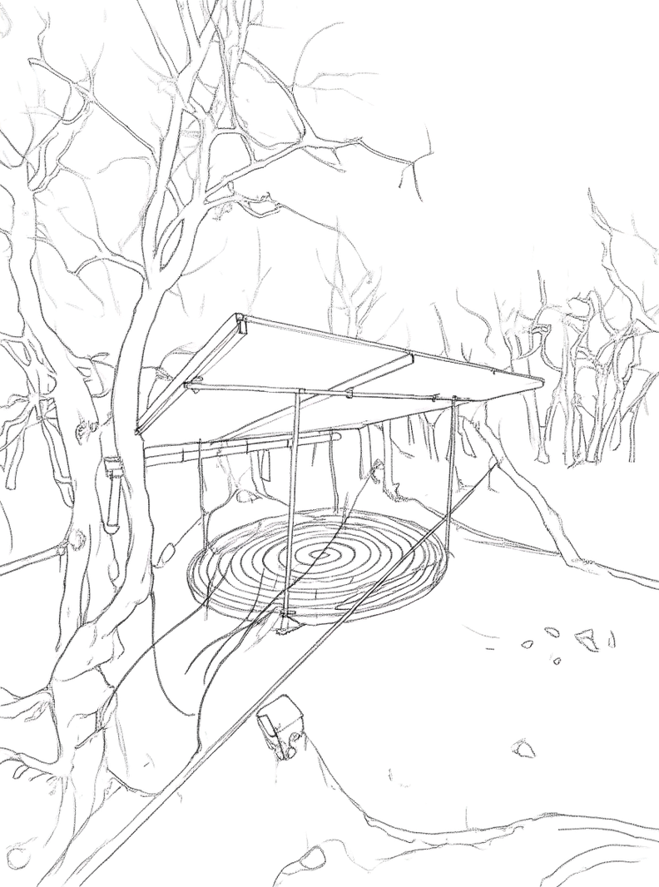
Presentation Flow
A JOURNEY THROUGH
  What is AnaEE-ERIC
  What we offer
  How to get service access
  Interested to join?

Slide 3
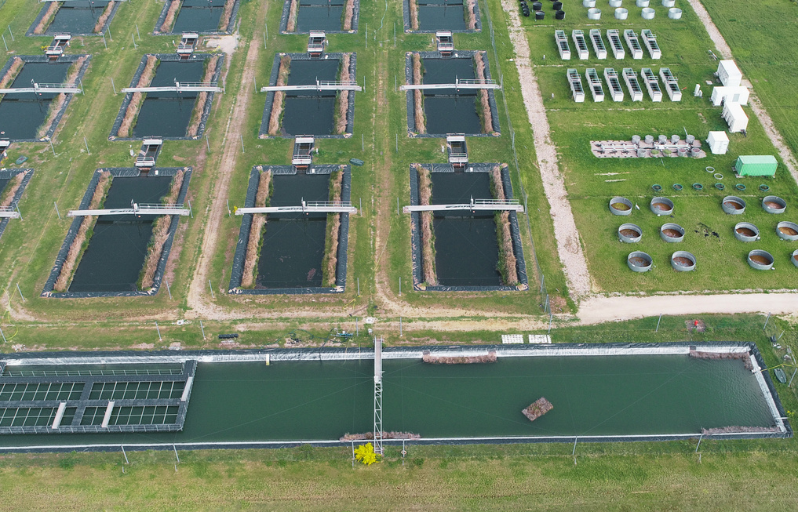
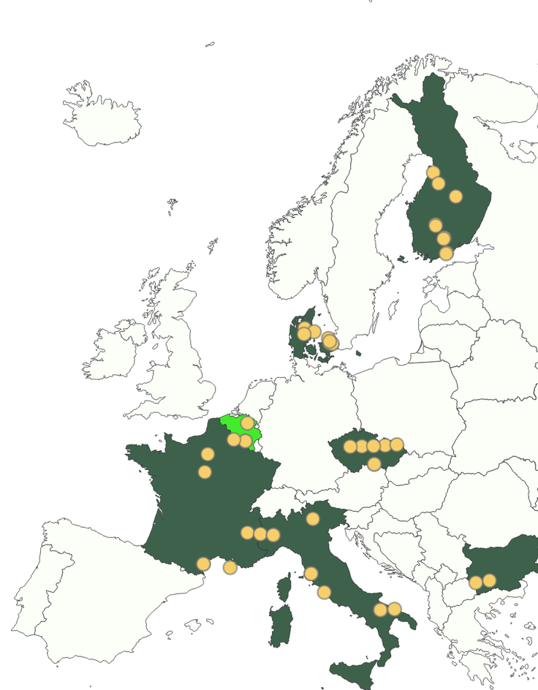
About AnaEE-ERIC
WHAT WE ARE
AnaEE-ERIC is a Landmark European Research Infrastructure network (you can think of it as an umbrella organisation) connecting cutting-edge facilities dedicated to global change ecology.
It is the study of how ecosystems work and respond to environmental change. We bring together experimental sites, analytical tools, and modelling capabilities to tackle pressing environmental challenges.

Slide 4
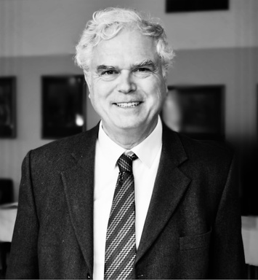
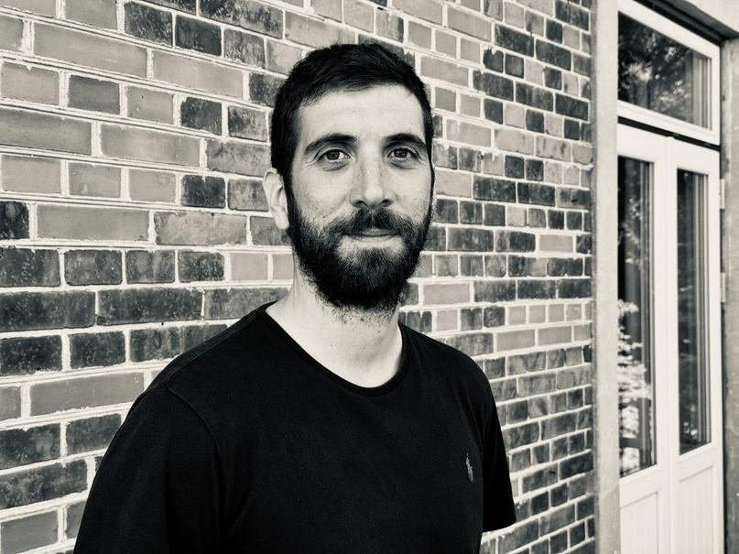


Who we are
MICHEL BOËR
ADRIANO PALMA
BILJANA ĐORĐEVIĆ
RACHEL BURNS
Central Hub,
Paris
Data and Modelling Centre, Rome
Interface and Synthesis Centre, Brno
Technology Centre, Copenhagen
Central Hub (CH): Manages the strategy, coordination, communication, administration, and web portal that provides access to all AnaEE resources across the distributed infrastructure.
Data and Modelling Centre (DMC): Processes data and metadata, provides data access to users and the community, manages models and the model factory, and organizes workshops and training.
Interface and Synthesis Centre (ISC): Integrates research results, produces synthesis papers and expert opinions, addresses societal needs and policy demands, and handles training and outreach activities.
Technology Centre (TC): Monitors emerging technologies, coordinates instrumentation and methods across facilities, manages technology spin-offs, and provides training for users and operators.

Slide 5




Vision mission and goals
SCIENCE FOR A RESILIENT FUTURE
VISION
MISSION
GOAL
To become the international reference organisation for Global Change Ecology and sustainable ecosystem services.
Understand how human drivers like climate change affect ecosystem functions. We simulate future conditions to address Europe’s ecological sustainability challenges.
Operate a pan-European network of experimental ecology facilities open to the scientific community, industry, land managers, and farming communities.

Slide 6
2.
What we offer

Slide 7

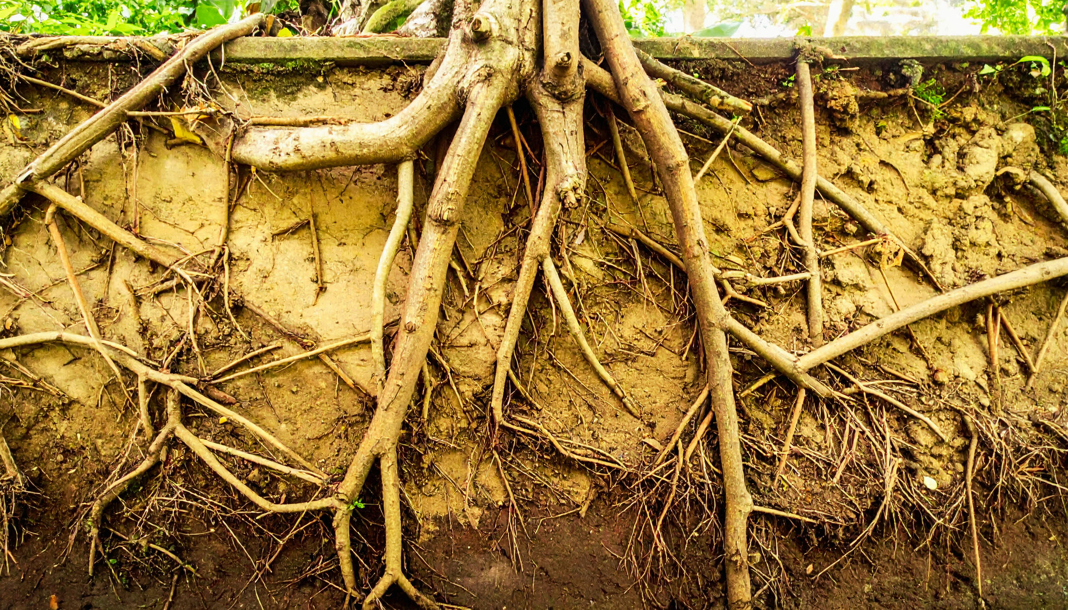
3
Manipulation
Modelling Mitigation
FROM MICROBES TO SOCIETY
AnaEE-ERIC has a unique service offer covering ecosystem sciences from the soil and plant microbiomes to ecosystems and biodiverstiy to land use impacts on ecosystems and climate resilience.
We offer a wide variety of services depending on if you are a policy maker, member, partner RI or private sector.

Slide 8
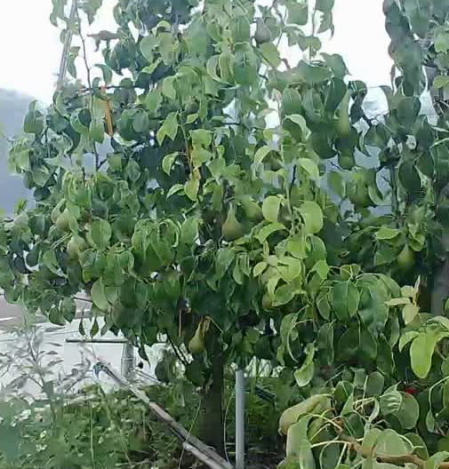
Our facilities
At the core are our three types of facilities that can impose multiple global change drivers to better understand their roles and identify their interactions.
1.
EXPERIMENTAL FACILITIES
Our facilities combine open-air and enclosed systems — including aquatic facilities — to enable cutting-edge ecological research. Open-air setups allow long-term, realistic experiments by manipulating multiple global change drivers in diverse ecosystems, while enclosed facilities provide precise environmental control and advanced measurements. Together, they deliver critical insights into ecosystem function, resilience, and adaptive responses to environmental change, supporting both gradual process studies and in-depth, data-driven experiments.

Slide 9


2.
MODELLING FACILITIES
Our advanced modeling facilities with state-of-the-art tools simulate and analyse complex environmental systems, supporting research on climate change and shifting dynamics in agriculture, forestry, and ecosystems. These tools enable efficient forecasting, data validation, and informed decision-making, helping researchers improve analyses, design better experiments, and predict ecosystem responses to global change.

Slide 10
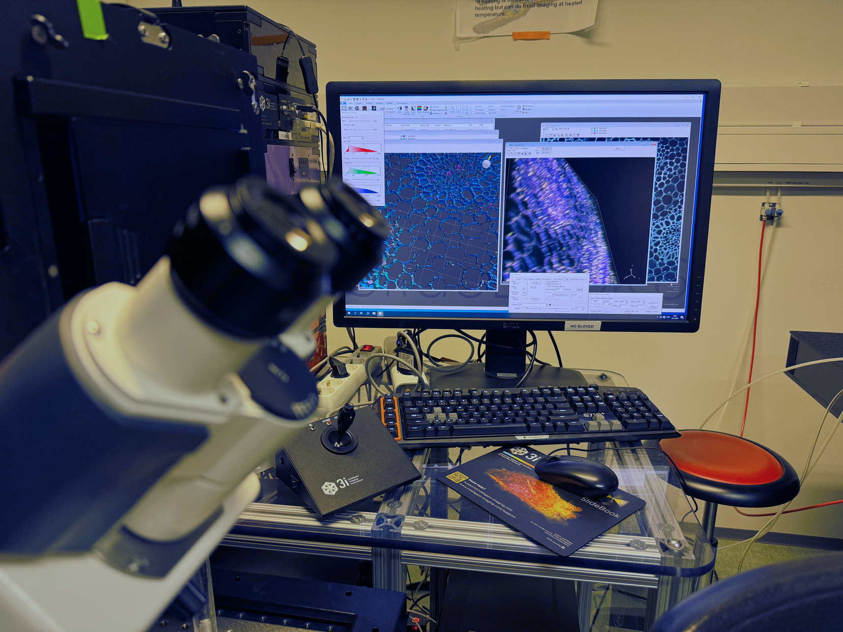
3.
ANALYTICAL FACILITIES
Our analytical facilities provide advanced, high-standard services that complement experimental research by offering unique capabilities and cutting-edge methodologies. These include mobile and remote sensing analyses, advanced omics laboratories, and food safety testing, enabling comprehensive and innovative ecosystem research.

Slide 11



Benefits for
AnaEE Members
1. Joint European project applications: access to established consortia, Horizon Europe calls, and coordinated proposal development for greater funding leverage.
2. Standardization & quality: shared procedures, harmonised quality checks, and hands-on support for platform development.
3. Scientific & project coordination: strategic roadmapping, multi-platform experiment management, and end-to-end project support.
4. Industry engagement & procurement: coordinated engagement with industry partners and shared procurement for greater efficiency and reach.
5. Training & visibility: staff training, workshops and events, and strategic communication to amplify your research impact across Europe.

Slide 12

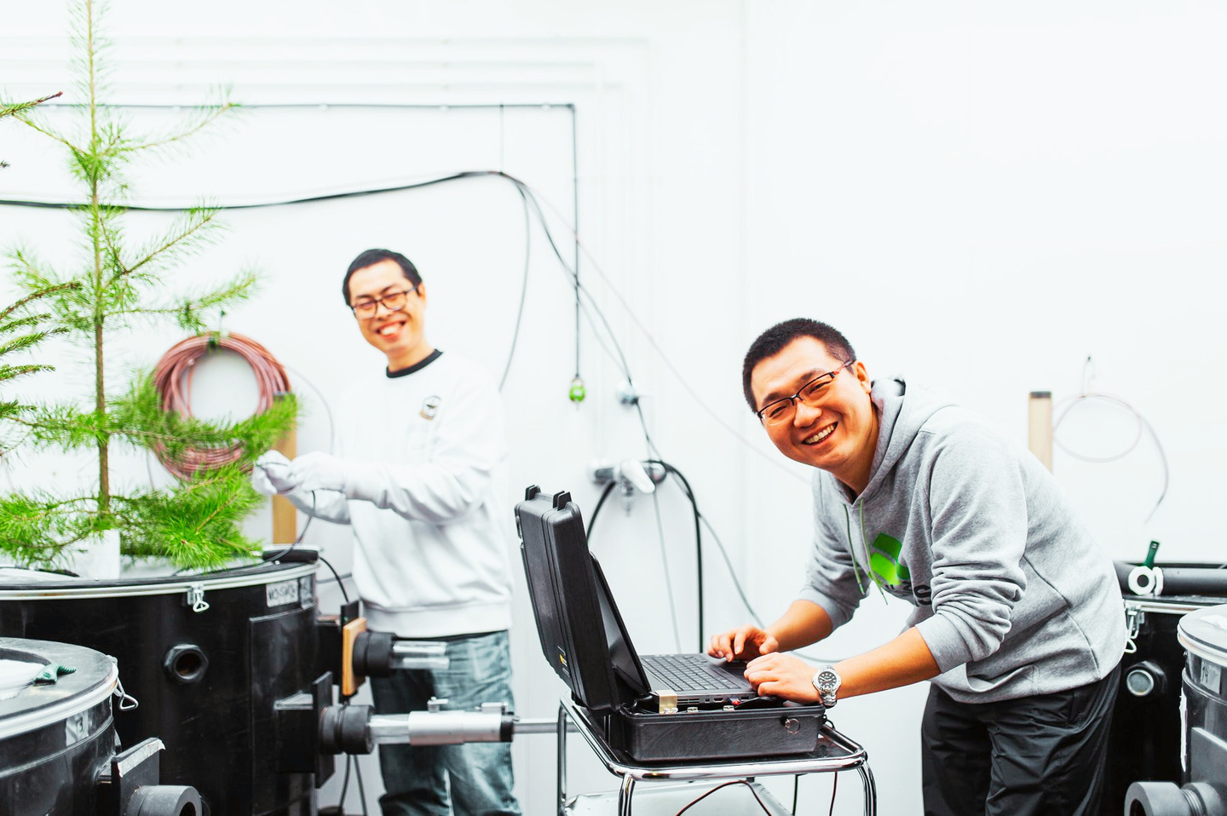
Benefits for the
Scientific Community
AnaEE-ERIC is open to researchers and scientists from the public and private sector.
  One-stop access: a full catalogue of research platforms, infrastructures, and clear guidance on applications and costs.
  Open data & advanced tools: access to AnaEE-ERIC’s research facilities, datasets, metadata, and integrated analytical/modelling services.
  Training & support: for researchers and advanced students to maximize the use of AnaEE’s resources.
  Test new technology: Tests of new producs, technologies and management methods for agriculture

Slide 13


Benefits for
Policymakers & Society
  Expert guidance & impact assessment: providing public advice, evidence, and tools to evaluate real-world impacts.
  Education & outreach: training for school children, the public, and coordinating networks for broader engagement.
  EU-wide citizen awareness: driving outreach activities to inform and involve communities across Europe.

Slide 14
3.
How to get access

Slide 15
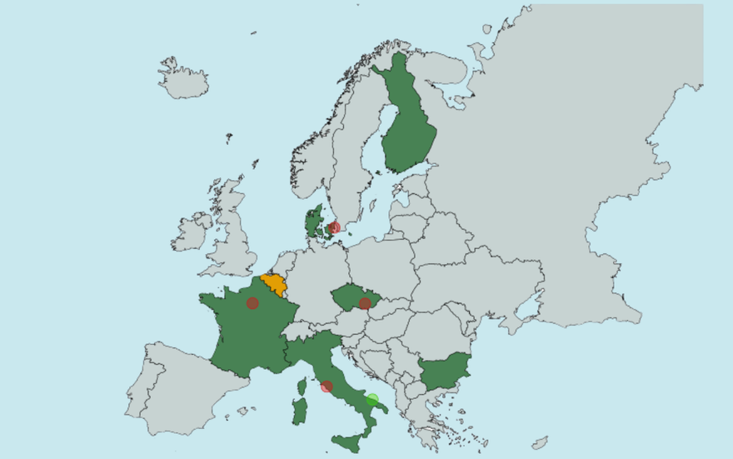


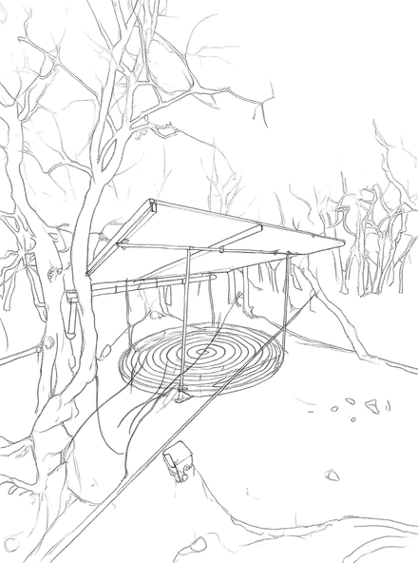




National Nodes
ANAEE'S SERVICES TO ITS USER COMMUNITY
  Coordinate national facilities
  Implement AnaEE standards
  Support users and access
  Build national capactity
  Engage with national stakeholders
Central Hub
  Single-entry access
  Coordination and management
  Strategy and visibility
ANALYTICAL & MODELLING FACILITIES
EXPERIMENTAL
FACILITIES
SERVICE CENTRES
Technology Centre
Data & Modelling Centree
Interface & Synthesis Centre
  Experiment standards
  Standardised instruments
  Technological innovation
  Data and metadata
  Modelling and upscaling
  FARI data standards
  Science-policy integration
  Cross-disciplinary synthesis
  Stakeholder engagement

Slide 16
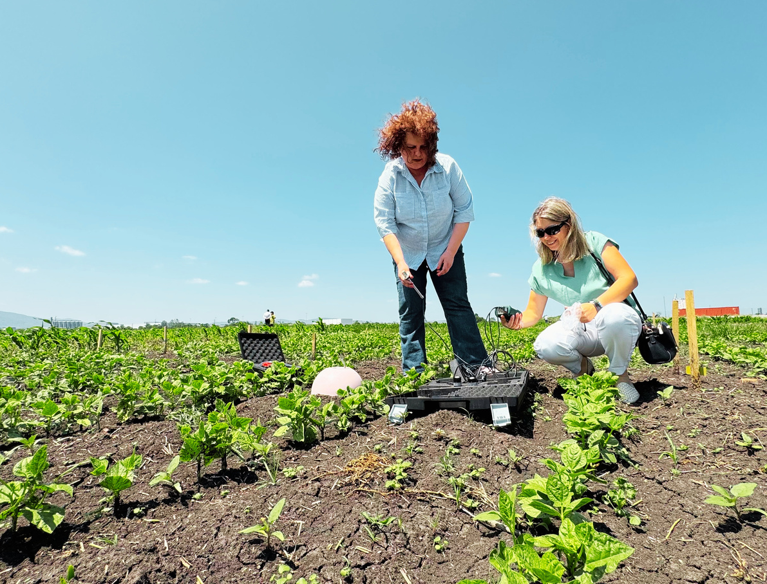



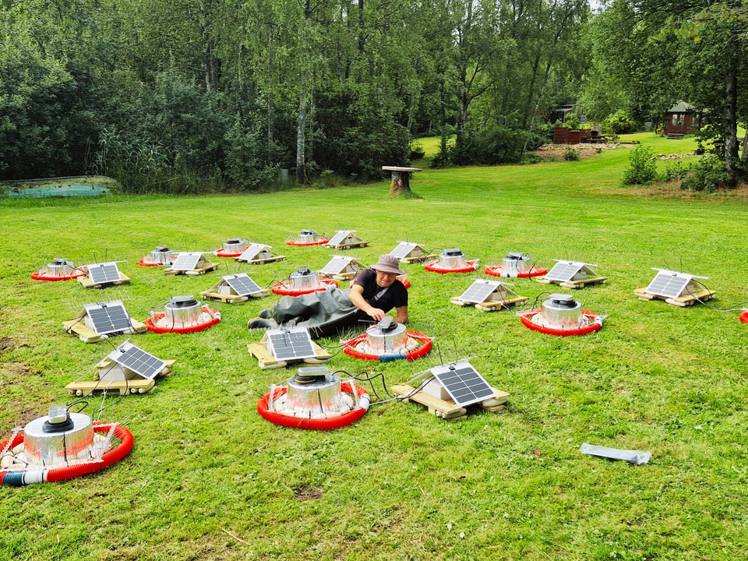




DIRECT CALLS AND PROJECTS
ACCESS PAGE
Get quick access to our facilities with Direct Access, or dive into a longer-term collaboration through Project Access. Either way, AnaEE-ERIC makes it easy to use our labs, platforms, and expertise for your research.
Direct Access – fast and flexible
Quick, pay-per-use access to labs, platforms, and services. Ideal for short-term experiments or pilot studies.
Project Access – Collaborative & Funded
Long-term access for research groups, with support for proposals, scheduling, and sometimes funded participation through Horizon Europe. Includes technical guidance, lab analyses, and optional mentorship.

Slide 17
4.
Interested in joining?

Slide 18


CONTACT US
BECOMING A MEMBER
Becoming a member of AnaEE-ERIC elevates your scientific capabilities and embeds your facilities in a collaborative, forward-thinking European network. Drive innovation, support sustainable practices, and ensure your research has lasting impact on science and society.
DORRA GHARBI - ANAEE OPERATIONS AND CENTRAL ACCESS MANAGER

Slide 19
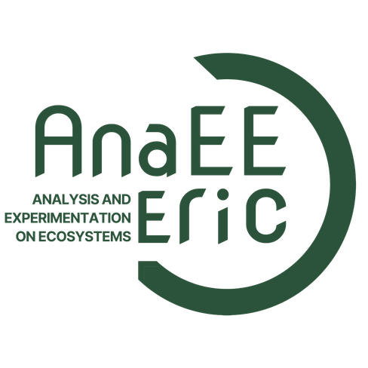
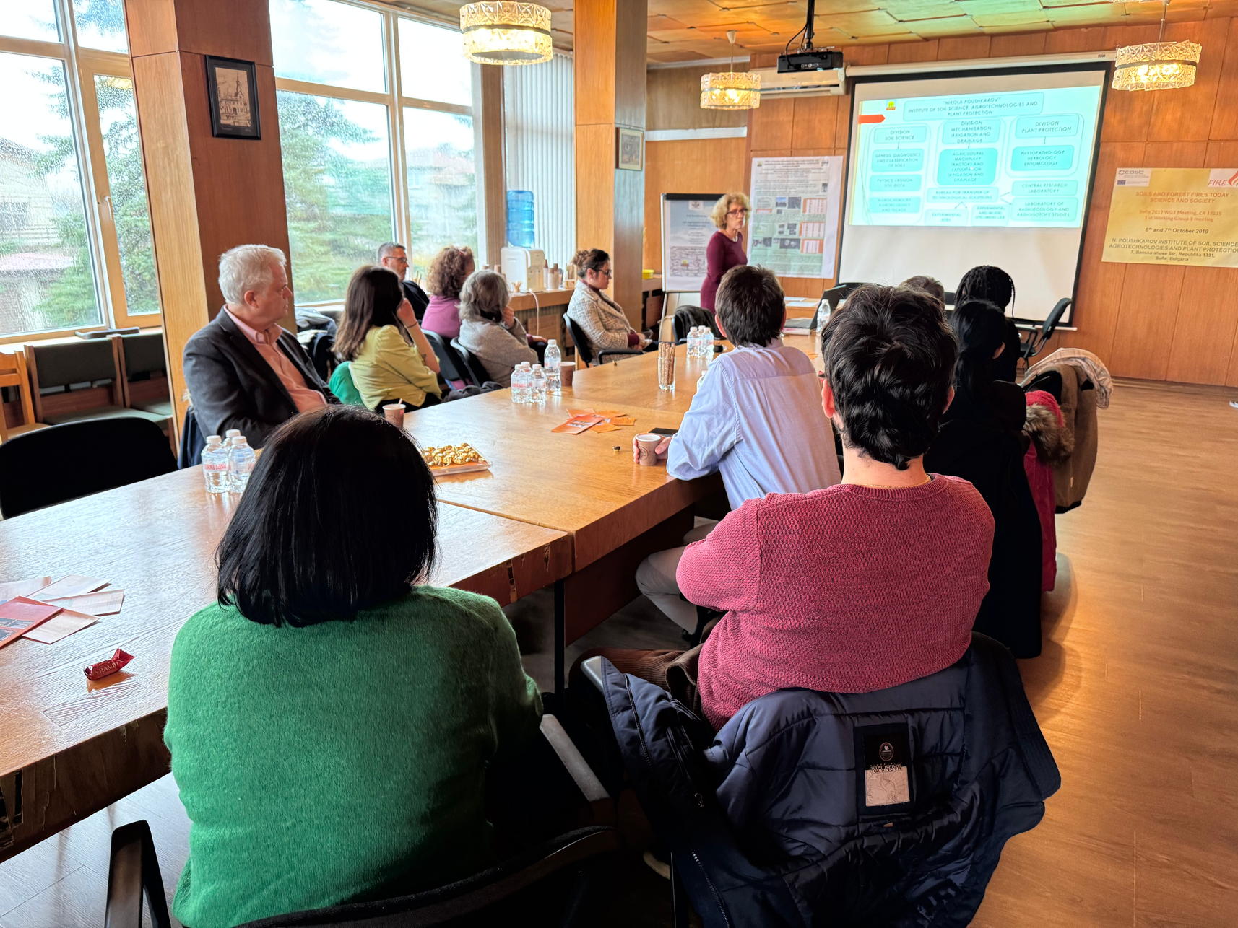
5 key requierments
  National Foundation: Establish a national node and consider forming a consortium agreement if multiple institutions are involved
  Facility Integration: Contribute state-of-the-art facilities within AnaEE scope – we provide support to meet required standard
  Government Backing: Secure backing from relevant ministry (education, research, agriculture, or ecology) and submit application
  Representation Setup: Appoint two government reps for Assembly of Members and national node rep for Extended Management Board
  Membership Agreement: Pay membership fee and ensure facilities provide international access under Service Level Agreement

Slide 20
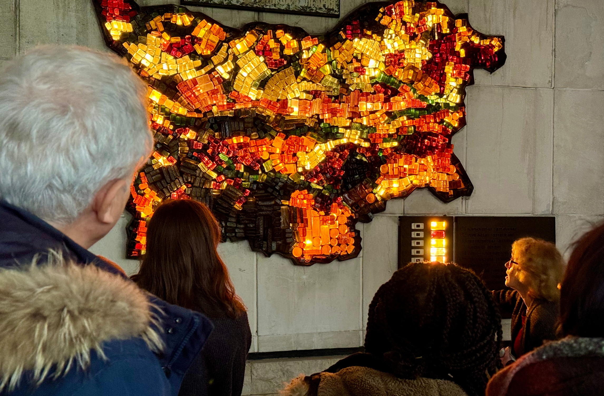
If you are considering becoming an
AnaEE-ERIC member - do not hesitate to contact us - we support you throughout the process

Slide 21

Thank you!
WE HOPE TO TALK TO YOU SOON!

